Slide 1

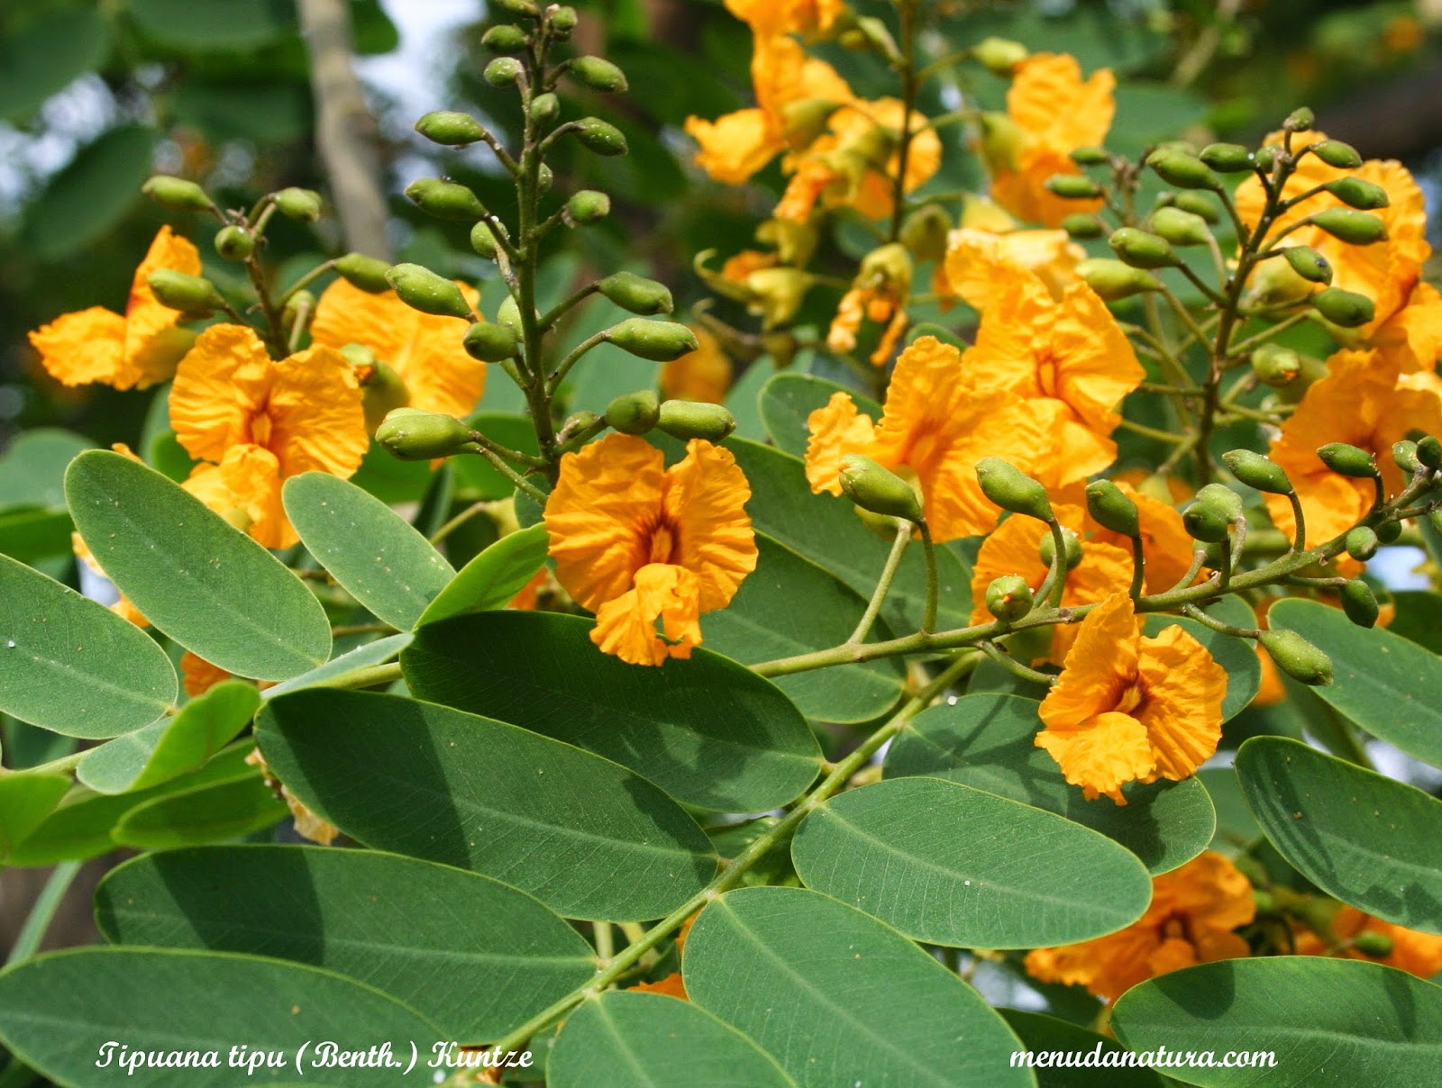
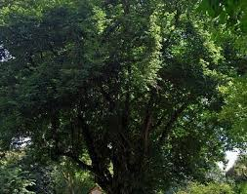
Indian rosewood
Near turf court –AIS campus Wakad
ThePhoto by PhotoAuthor is licensed under CCYYSA.

Slide 2
Common Name : Indian Rosewood, Shisham,
Scientific Name : Dalbergia sissoo
Family : Fabaceae.
Habit : The Indian Rosewood (Dalbergia sissoo) is a large deciduous tree, typically growing 20-25 meters tall. It has a broad crown with dense, compound leaves that are dark green. The tree sheds its leaves during the dry season and regrows them with the onset of rains.
Distribution : Native to the Indian subcontinent, the Indian Rosewood is widely distributed northern and central India, including Punjab, Uttar Pradesh, and Madhya Pradesh. It thrives in tropical and subtropical climates and is also found in Pakistan, Nepal, and Bangladesh. Additionally, it has been introduced to other tropical regions worldwide.

Slide 3
Description :
Bark and Trunk: The Indian Rosewood has a straight, sturdy trunk with greyish-brown bark that tends to be rough and fissured. The trunk can reach a diameter of up to 2-3 meters. The wood is dense and durable, often used for furniture and construction.
Leaves: The leaves are compound, comprising 3-5 oval leaflets that are dark green and leathery in texture. The leaflets are about 2-6 cm long, providing a lush canopy.
Flowers: During the spring, the tree produces small, fragrant flowers that are yellowish-white in color. These flowers are borne in loose clusters and are a source of nectar for bees and other pollinators.
Fruits: The tree bears flat, brown pods that are 4-8 cm long. Each pod contains 1-5 flat, brown seeds. The pods mature in the winter and often remain on the tree until the following growing season.
Growth and Lifespan: Indian Rosewood is a fast-growing tree, capable of thriving in a variety of soil conditions, including sandy and loamy soils. It is drought-resistant and can tolerate high temperatures, making it well-suited to its native tropical and subtropical environments. The tree has a long lifespan, often living for over 100 years.

Slide 4
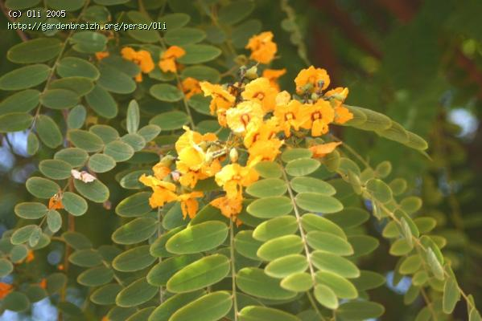
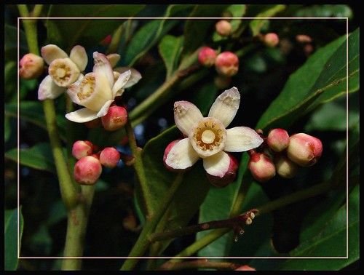
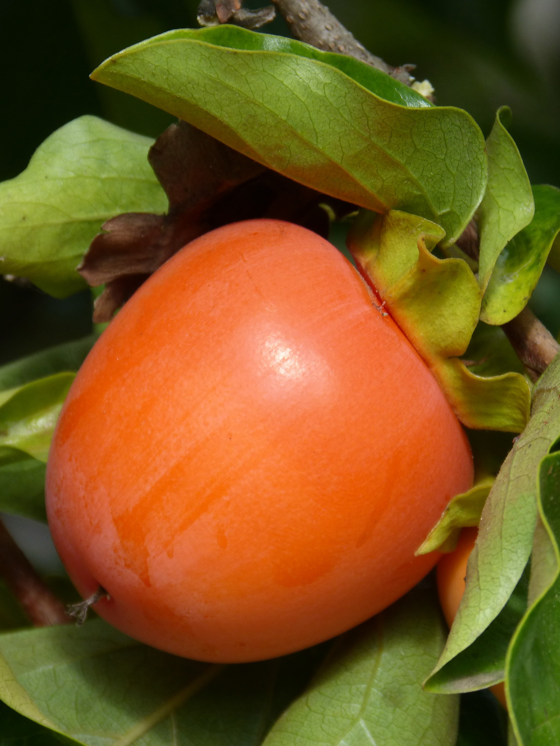
USES

Slide 5
Wood (Trunk and Branches):
Furniture and Carpentry: The wood is highly valued for making furniture, cabinets, and decorative items due to its durability and attractive grain.
Construction: Used in construction for making doors, window frames, and flooring because of its strength and resistance to termites.
Musical Instruments: The dense wood is also used to craft musical instruments, such as guitars and sitars, for its excellent tonal qualities.
Leaves:
Fodder: The leaves are often used as fodder for livestock, providing a nutritious supplement during the dry season.
Medicinal Uses: In traditional medicine, the leaves are used for treating skin disorders and wound healing.
Green Manure: The fallen leaves enrich the soil as green manure, improving fertility and soil structure.

Slide 6
Flowers:
Nectar Source: The flowers provide nectar for bees, making the tree important for honey production.
Aesthetic Value: The fragrant flowers add aesthetic value and are sometimes used in traditional ceremonies and decorations.
Pods and Seeds:
Propagation: The seeds are used to propagate the tree for reforestation and afforestation projects.
Traditional Medicine: The seeds are sometimes used in traditional remedies for various ailments.
Bark:
Tannins: The bark contains tannins, which are used in leather tanning.
Medicinal Uses: The bark is used in Ayurvedic medicine to treat conditions like dysentery and diarrhea. It is also believed to have anti-inflammatory properties.
Roots:
Soil Stabilization: The deep-rooted system helps in soil stabilization, preventing erosion in riverbanks and hilly areas.
Medicinal Uses: The roots are sometimes used in traditional medicine for their purported anti-inflammatory and analgesic properties.

